Slide 1
Fake News Detection Project Using Machine Learning and Natural Language Processing: Prepared By:- Abhinav Kumar

Slide 2
Fake News Detection Using Machine Learning and Natural Language Processing: Introduction:- Classification of any news item /post / blog into fake or real one has generated great interest from researchers around the globe. Several research studies have been carried out to find effect of falsified and fabricated news on masses and reactions of people upon coming through such news items. Falsified news or fabricated posts, news is any textual or non-textual content that is fake and is generated so the readers will start believing in something which is not true. The credibility of social media networks is also at stake where the spreading of fake information is prevalent. Thus, it has become a research challenge to automatically check the information viz a viz its source, content and publisher for categorizing it as false or true. Machine learning has played a vital role in classification of the information although with some limitations.

Slide 3
How the detection of fake news came in light:- The spread of fake news has far reaching consequences like creation of biased opinions to swaying election outcomes for the benefit of certain candidates. Moreover, spammers use appealing news headlines to generate revenue using advertisements via click-baits. In the recent elections of United States, there has been much debate regarding the authenticity of various news reports favoring certain candidates and the political motives behind them. Amidst such growing concerns, the detection of fake news gains utmost importance to prevent its negative impacts on individuals and society.

Slide 4
Old methodology vs new method for fake news detection:- When detecting fake news from a knowledge-based perspective, one often uses a process known as fact-checking. Fact checking, initially developed in journalism, aims to assess news authenticity by comparing the knowledge extracted from to-be-verified news content (e.g., its claims or statements) with known facts. Expert-based fact-checking relies on domain-experts as fact-checkers to verify the given news contents. Manual fact-checking does not scale with the volume of newly created information, especially on social media. To address scalability, automatic fact-checking techniques have been developed, heavily relying on Information Retrieval (IR), Natural Language Processing (NLP), and Machine Learning (ML) techniques.

Slide 5
Building an effective Machine Learning Model:- As we can see from the dataset that our major concern is to differentiate between the fake and reliable news i.e. why in order to solve the above problem we need to create a model that can be helpful in predicting the above . As we can see that the output is discrete in nature so we will go for the classification models. We have various classifiers in machine learning:- 1. Logistic Regressor 2. Naïve bayes classifier 3. Decision tree classifier 4. KNeighbors classifier 5. Support Vector machine and so on…

Slide 6
Steps in building an effective machine learning based model:- 1. Performing the end to end Exploratory Data Analysis. It is one of the important step in creating a model where we will remove the unwanted columns or redundancies from the dataset. 2. Data Preprocessing Activities:- We must perform a careful EDA process in the dataset in order to know the structure of the data. EDA includes checking the shape of the dataset, datatypes of the variable in the dataset, checking of the null values and replacing null values with some relevant values, converting the variables in object data type to int and float so that they can be useful in data visualization further.

Slide 7
3. Splitting the dataset in dependent and independent sets:- After we have performed our exploratory data analysis the next step is to divide the dataset into X and Y where X is independent variable and Y is independent variable. 4. Data Visualization:- Data visualization is the representation of data or information in a graph, chart, or other visual format. Machine learning makes it easier to conduct analyses such as predictive analysis, which can then serve as helpful visualizations to present.

Slide 8
For data visualization python provides an inbuilt libraries which are seaborn and matplotlib with the help of which we can plot different types of graphs. For our given dataset we have visualized Countplot to check the count of fake and reliable news. Seaborn distplot lets you show a histogram with a line on it We use seaborn in combination with matplotlib, the Python plotting module. A distplot plots a univariate distribution of observations. A Word cloud (or Tag cloud) is a visual representation of text data. It displays a list of words, the importance of each beeing shown with font size or color. This format is useful for quickly perceiving the most prominent terms.

Slide 9
As from the data set we can see that our data is not in the form of vectors, to build an effective machine learning based model we need to convert the data into numerical form but before that we have to do some preprocessing where we will come across the concepts of natural language processing like removing stop words, stemming and use of count vectorizer. So to start with the natural language processing we need to import natural language tool kit package (nltk). STOP WORDS:- Stop words are the English words which does not add much meaning to a sentence. They can safely be ignored without sacrificing the meaning of the sentence. For example, the words like the, he, have etc. Such words are already captured this in corpus named corpus. STEMMING:- Stemming is a technique used to extract the base form of the words by removing affixes from them. It is just like cutting down the branches of a tree to its stems. For example, the stem of the words eating, eats, eaten is eat. Search engines use stemming for indexing the words.

Slide 10
COUNT VECTORIZER:- Count Vectorizer is a great tool provided by the scikit-learn library in Python. It is used to transform a given text into a vector on the basis of the frequency (count) of each word that occurs in the entire text. We also have other methods to convert the data into vectors like Tf-Idf technique TF-IDF is a statistical measure that evaluates how relevant a word is to a document in a collection of documents. TF-IDF (term frequency-inverse document frequency) was invented for document search and information retrieval. Where term freq=(no of times word occurred in document/total number of words in a document).

Slide 11
After applying count vectorizer and converting the same in array we will convert our X data into data frame. After we have our data frame we will check for outliers and we can see that there are many outliers present in the dataset which we have further removed using scipy.stats library, from where we will import z-score and calculate the value for z score and set up a threshold value. If the value is above threshold value we will consider it as an outlier. Now we are done with our exploratory data analysis, data visualization and removal of outliers so now we will move towards machine learning and will see how to create the effective machine learning based model from our obtained results.

Slide 12
Building Machine Learning Model:- The dataset that we are dealing with is a completely balanced dataset which we can see from the countplot that the gives the count of the fake and reliable news. So there is no need to go for balancing. We will now split our dataset into x train, x test, y train, y test using sklearn train test split method. We will give 33 percent of data for our testing purpose and rest for training purpose. For our data we have used logistic regression, Multinomial NB and Decision Tree classifier. We have tested our data on these models and interpreted different results. Further we have calculated different metrices for these models like accuracy score, F1 score, log loss, precision, recall.

Slide 13
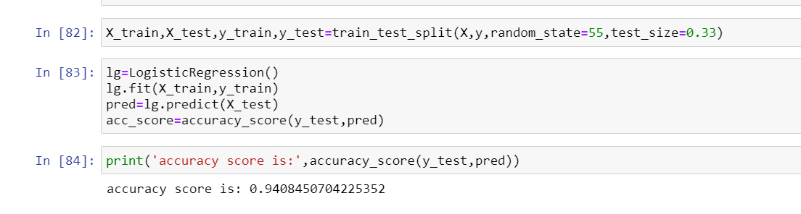
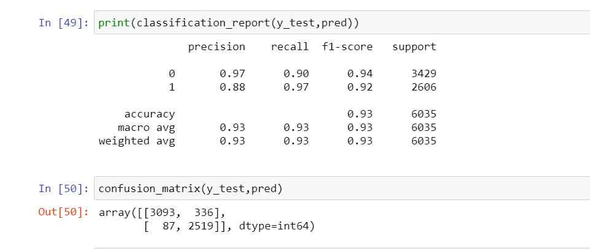
Logistic regression:- Logistic Regression is a Machine Learning technique used to estimate relationships among variables using statistical methods. This algorithm is great for binary classification problems as it deals with predicting probabilities of classes, and hence our decision to choose this algorithm as our base-line run. It relies on fitting the probability of true scenarios to the proportion of actual true scenarios observed. Also, this algorithm does not require large sample sizes to start giving fairly good results. Interpretation from the result:-

Slide 14
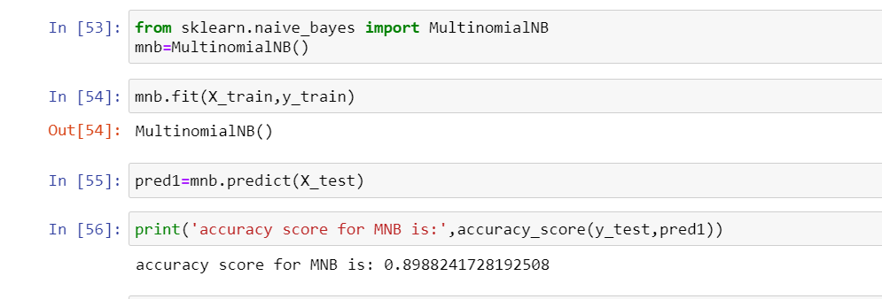
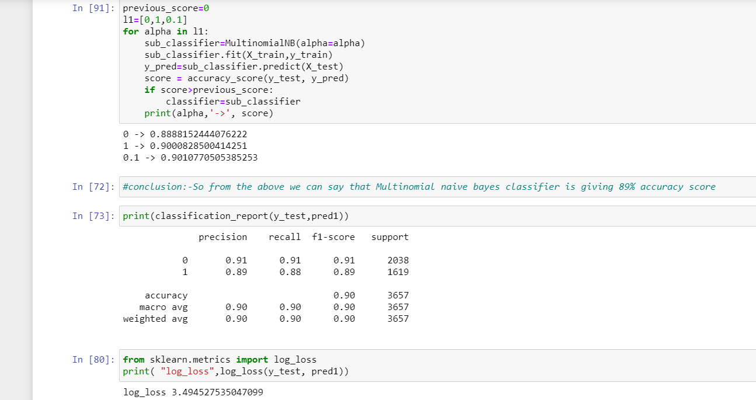
Naïve Bayes Classifier:- This is a simple yet powerful classification model that works remarkably well. It uses probabilities of the elements belonging to each class to form a prediction. The underlying assumption in the Naïve Bayes model is that the probabilities of an attribute belonging to a class is independent of the other attributes of that class. Hence the name ‘Naive’. In this model we multiply the conditional probabilities of each attribute given the class value, to get the probability of the test data belonging to that class. We arrive at the final prediction by selecting the class that has the highest of the probabilities for the instance belonging to that class. Interpretation from the result:-

Slide 15
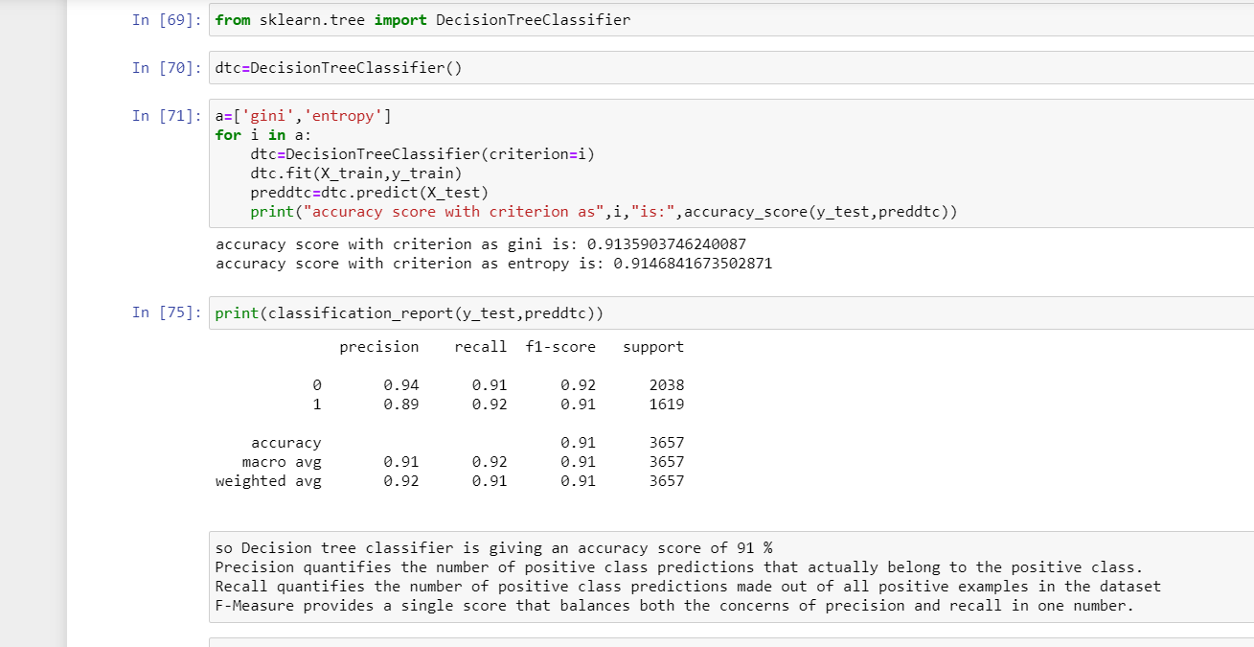
Decision Tree Classifier: - Decision trees use multiple algorithms to decide to split a node into two or more sub-nodes. The creation of sub-nodes increases the homogeneity of resultant sub-nodes. The decision tree splits the nodes on all available variables and then selects the split which results in most homogeneous sub-nodes.

Slide 16
Findings from all the models tested above on this dataset:- We have classified our news data using three classification models. We have analysed the performance of the models using accuracy and confusion matrix. Naïve Bayes performed very poorly. Logistic Regression surprisingly performed very well, as observed from the above results Logistic regression performed slightly better than Multinomial NB and Decision tree classifier. The accuracy of the models used is below: - 1. Logistic Regression – 94 % 2. Multinomial NB – 90 % 3. Decision Tree Classifier – 91%

Slide 17
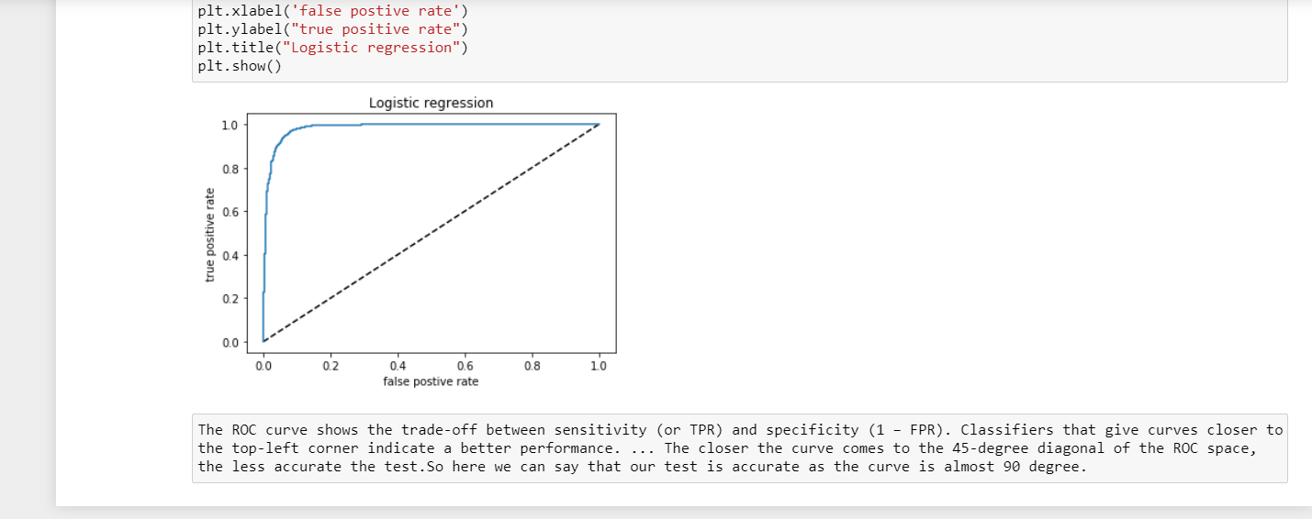
AUC- ROC Curve: - The Receiver Operator Characteristic (ROC) curve is an evaluation metric for binary classification problems. It is a probability curve that plots the TPR against FPR at various threshold values and essentially separates the ‘signal’ from the ‘noise’. The Area Under the Curve (AUC) is the measure of the ability of a classifier to distinguish between classes and is used as a summary of the ROC curve.

Slide 18
THANK YOU : -

